Slide 1
Comparison between f" and f´
f´ generally produce thicker edges in an image
f" have a stronger response to fine detail
f´ generally have a stronger response to a gray-level step
f" produces double response at step changes in gray level
f" responses given similar changes in gray-level values
point > step > line
For image enhancement, f" is generally better suited than f´
Major application of f´ is for edge extraction;
f´ used together with f" results in impressive enhancement effect
COMSATS University Islamabad, Lahore Campus Digital Image Processing CSD 331

Slide 2
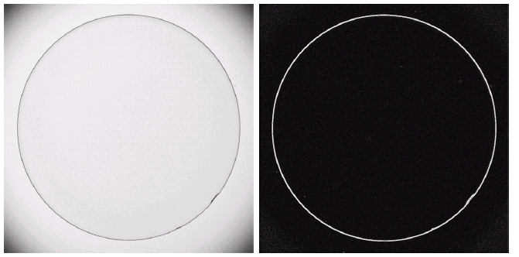
Example
Optical image of contact lens (note defects at 4 and 5 o’ clock
Sobel gradient
COMSATS University Islamabad, Lahore Campus Digital Image Processing CSD 331

Slide 3
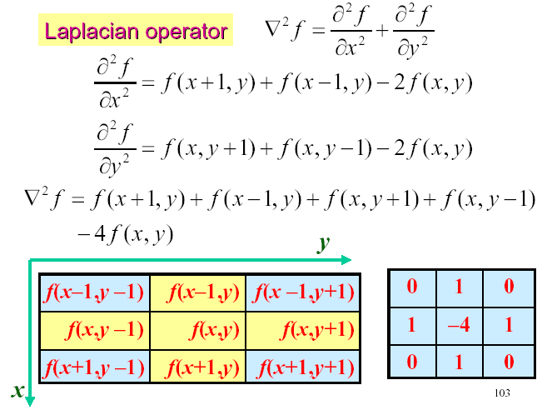
Laplacian for image enhancement
COMSATS University Islamabad, Lahore Campus Digital Image Processing CSD 331

Slide 4
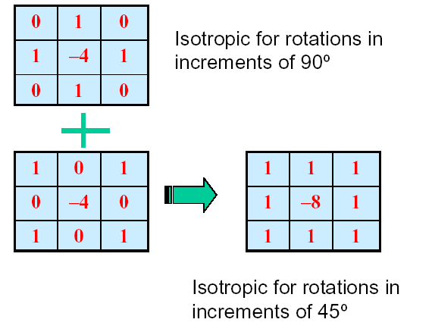
Laplacian for image enhancement
COMSATS University Islamabad, Lahore Campus Digital Image Processing CSD 331

Slide 5

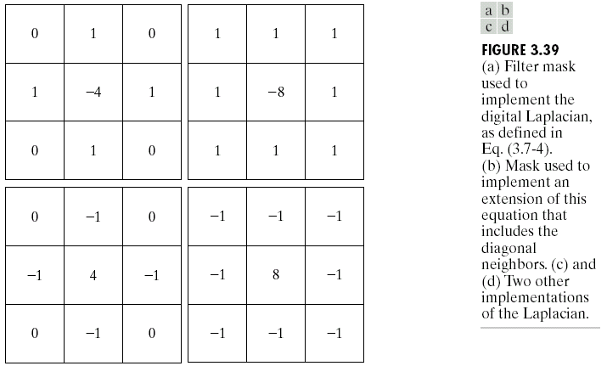
Laplacian for image enhancement
COMSATS University Islamabad, Lahore Campus Digital Image Processing CSD 331

Slide 6
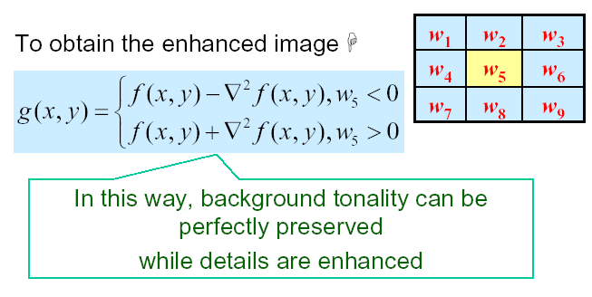
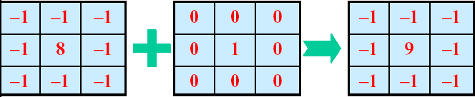
Laplacian for image enhancement
COMSATS University Islamabad, Lahore Campus Digital Image Processing CSD 331

Slide 7
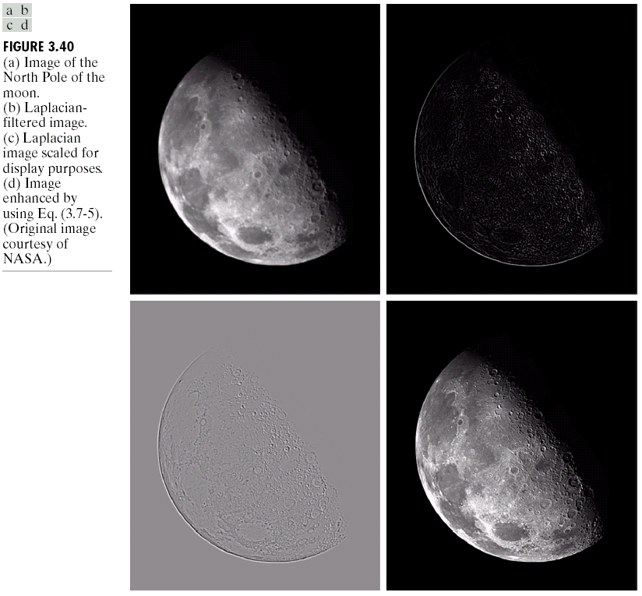
Laplacian for image enhancement (example)
COMSATS University Islamabad, Lahore Campus Digital Image Processing CSD 331

Slide 8
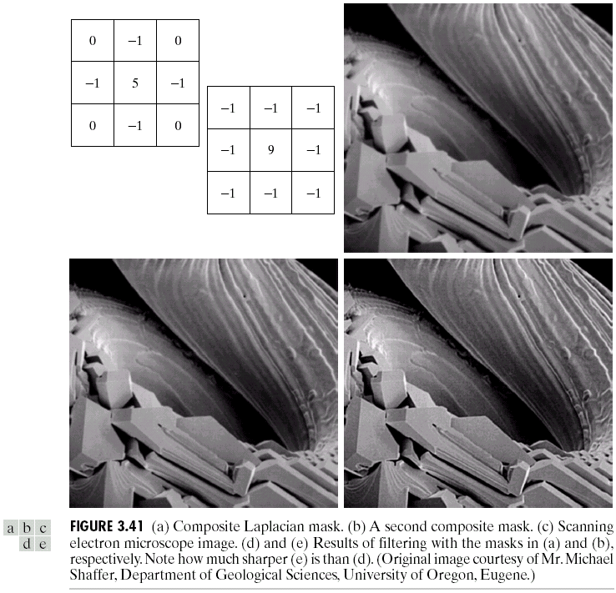
Laplacian for image enhancement (example)
COMSATS University Islamabad, Lahore Campus Digital Image Processing CSD 331

Slide 9
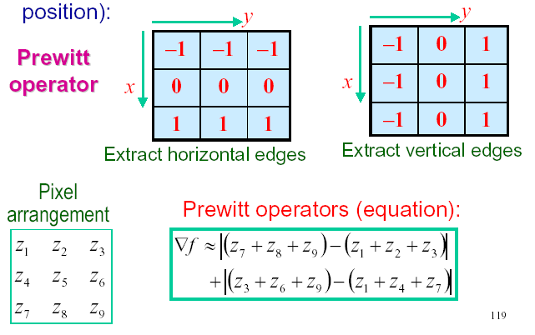
Gradient Operators
Normally the smallest mask used is of size 3 x 3
Based on the concept of approximating the gradient several spatial masks have been proposed:
COMSATS University Islamabad, Lahore Campus Digital Image Processing CSD 331

Slide 10
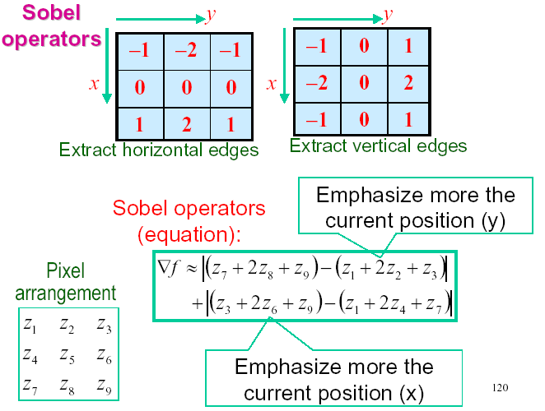
Gradient Operators
COMSATS University Islamabad, Lahore Campus Digital Image Processing CSD 331

Slide 11
Gradient Operators
Optical image of contact lens (note defects at 4 and 5 o’ clock
Sobel gradient
COMSATS University Islamabad, Lahore Campus Digital Image Processing CSD 331

Slide 12
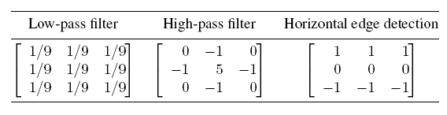
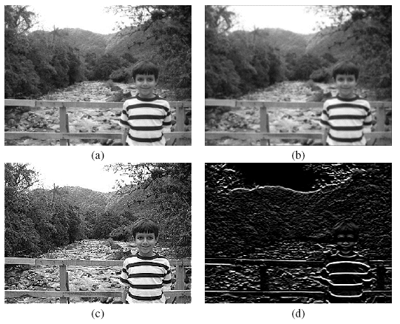
Summary
  Depending on the choice of mask coefficients, entirely different results can be obtained.
COMSATS University Islamabad, Lahore Campus Digital Image Processing CSD 331

Slide 13
Combining spatial enhancement methods
When faced with a practical image processing problem, a question arises:
Which techniques should I use and in which sequence ?
There is no universal answer to this question.
  Most image processing solutions are problem-specific and involve the application of several algorithms -- in a meaningful sequence -- to achieve the desired goal.
  The choice of algorithms and fine-tuning of their parameters is a trial-and-error process.
  Using the knowledge acquired so far you should be able to implement, configure, fine-tune, and combine image processing algorithms for a wide variety of real-world problems.
COMSATS University Islamabad, Lahore Campus Digital Image Processing CSD 331

Slide 14
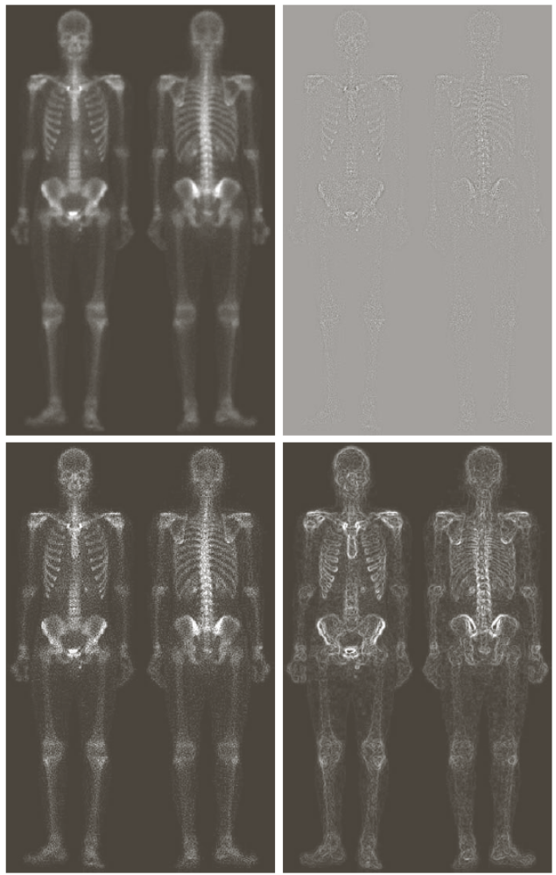
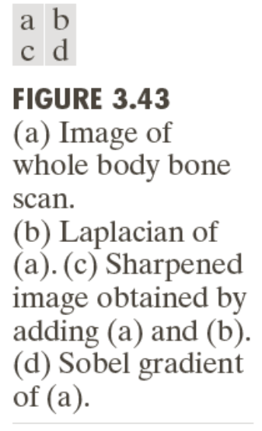
Combining spatial enhancement methods
COMSATS University Islamabad, Lahore Campus Digital Image Processing CSD 331

Slide 15
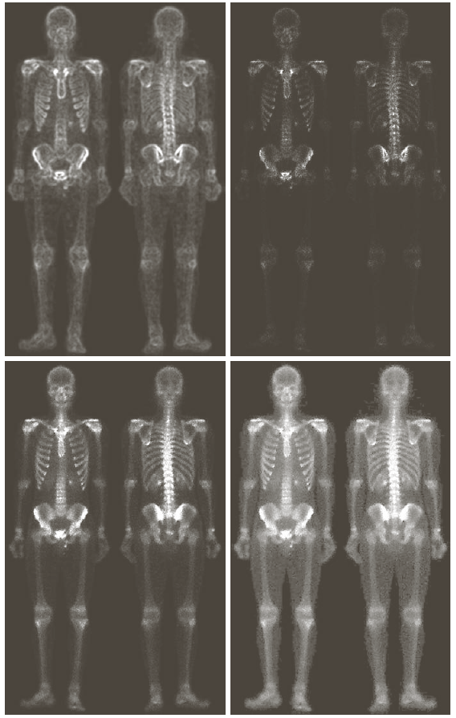
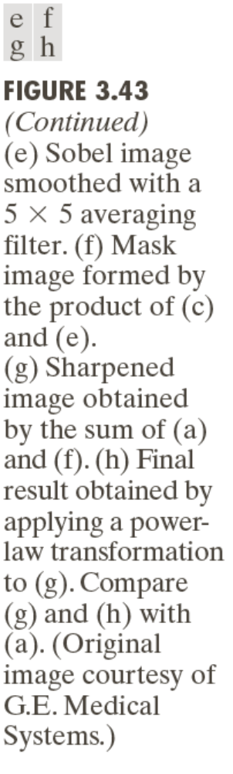
Combining spatial enhancement methods
COMSATS University Islamabad, Lahore Campus Digital Image Processing CSD 331

Slide 16
Hands On
Practical Image and Video Processing Using MATLAB – By Oge Marques
Tutorial 10.1: Convolution and correlation (page 223)
Tutorial 10.2: Smoothing filters in the spatial domain (page 225)
Tutorial 10.3: Sharpening filters in the spatial domain (page 228)
COMSATS University Islamabad, Lahore Campus Digital Image Processing CSD 331

Slide 17
Geometric Spatial Transformations (Rubber Sheet)
Modify the geometry of an image by repositioning pixels in a constrained way.
Modify the spatial relationships between groups of pixels representing features or objects of interest within the image.
Are used for different purposes:
  Correction of geometric distortions introduced during the image acquisition process;
  Special effects (e.g., twirling, bulging, or squeezing);
  As part of image registration
COMSATS University Islamabad, Lahore Campus Digital Image Processing CSD 331

Slide 18
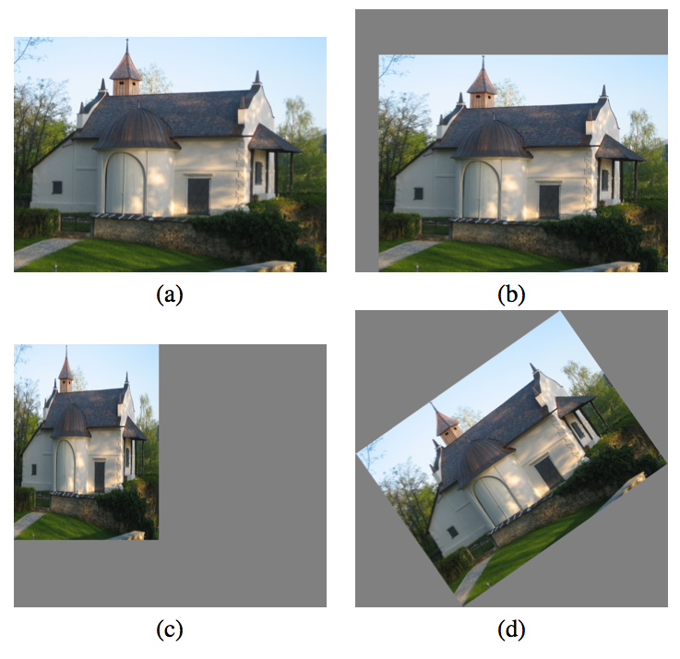
Geometric Spatial Transformations
COMSATS University Islamabad, Lahore Campus Digital Image Processing CSD 331

Slide 19
Geometric Spatial Transformations
Two basic components:
  mapping function, specified using a set of spatial transformation equations (and a procedure to solve them)
  and
  interpolation methods, used to compute the new value of each pixel in the spatially transformed image.
COMSATS University Islamabad, Lahore Campus Digital Image Processing CSD 331

Slide 20
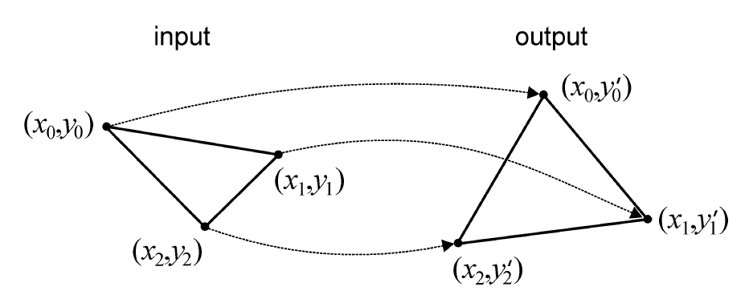


Geometric Spatial Transformations
COMSATS University Islamabad, Lahore Campus Digital Image Processing CSD 331

Slide 21

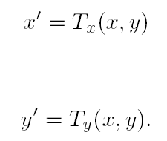
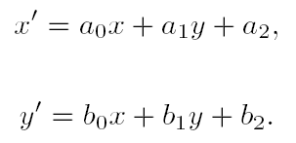
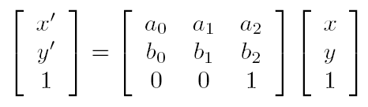
Geometric Spatial Transformations
COMSATS University Islamabad, Lahore Campus Digital Image Processing CSD 331

Slide 22
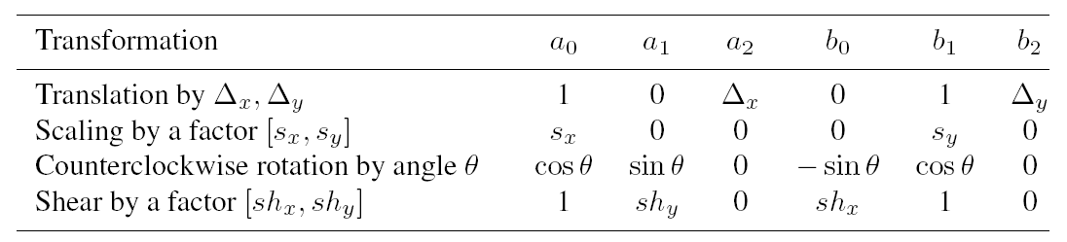
Geometric Spatial Transformations
COMSATS University Islamabad, Lahore Campus Digital Image Processing CSD 331

Slide 23
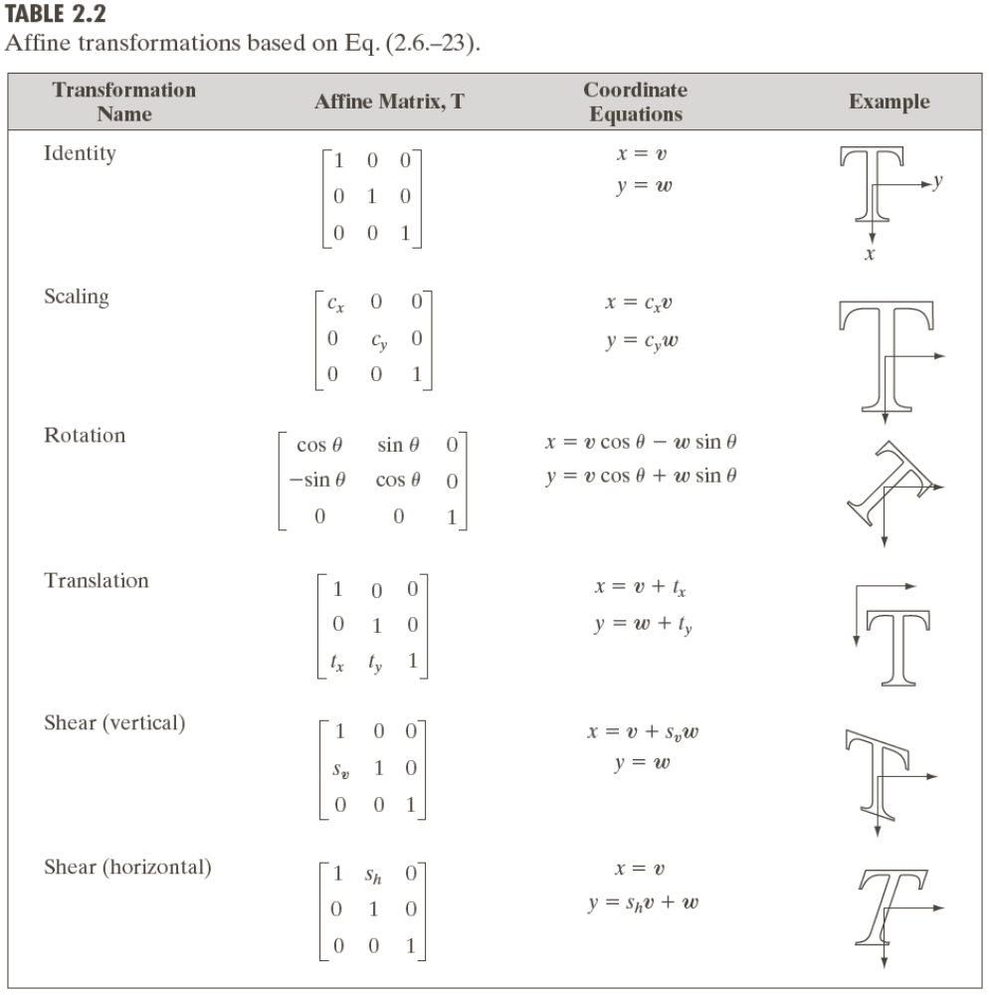
Geometric Spatial Transformations (Rubber Sheet)
COMSATS University Islamabad, Lahore Campus Digital Image Processing CSD 331

Slide 24
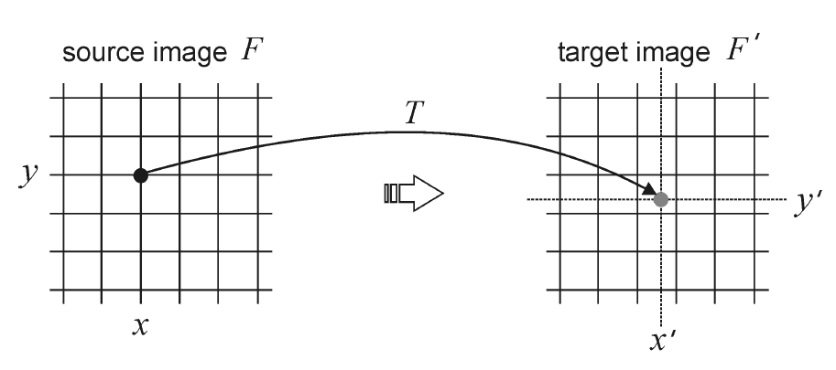
Geometric Spatial Transformations
Forward Mapping
COMSATS University Islamabad, Lahore Campus Digital Image Processing CSD 331

Slide 25
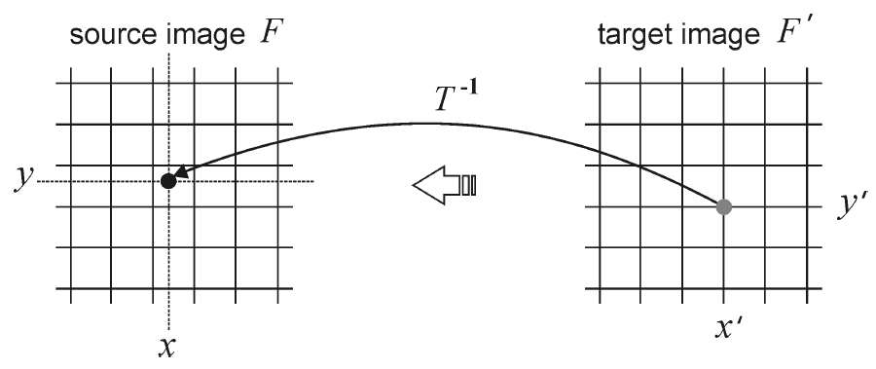
Geometric Spatial Transformations
Reverse Mapping
COMSATS University Islamabad, Lahore Campus Digital Image Processing CSD 331

Slide 26
Geometric Spatial Transformations (Rubber Sheet)
Forward Mapping
Scan through the source image pixel by pixel, and copy them to the appropriate place (as per transformation) in the destination image.
Some pixels in destination image don’t get any value (Gaps)
Some pixels in destination image get multiple values (Overlaps)
Reverse Mapping
Go through the destination image pixel by pixel, and sample the correct pixel from the source image by inverse of transformation.
COMSATS University Islamabad, Lahore Campus Digital Image Processing CSD 331

Slide 27
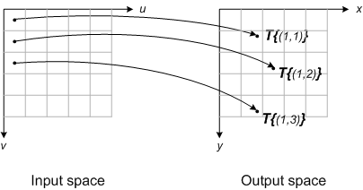
Forward Mapping
Consider each input image pixel in turn. For each input image pixel:
Determine its location in input space, (u_{k},v_{k}).
Map that location to output space using (x_{k},y_{k}) = T{(u_{k},v_{k})}.
Figure out which output pixel contains the location (x_{k},y_{k}).
Copy the input pixel value to that output pixel.
COMSATS University Islamabad, Lahore Campus Digital Image Processing CSD 331

Slide 28
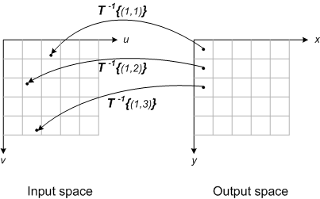
Reverse Mapping
Locate output image pixel grid somewhere in output space. Then for each output pixel on the grid:
Apply the inverse spatial transformation to determine the corresponding location in input space: (u_{k},v_{k}) = T⁻¹{(x_{k},y_{k})}.
Using the input image pixels nearest to (u_{k},v_{k}), interpolate to get an approximate value for the input image at (u_{k},v_{k}).
Use that value for the k-th output pixel.
COMSATS University Islamabad, Lahore Campus Digital Image Processing CSD 331

Slide 29
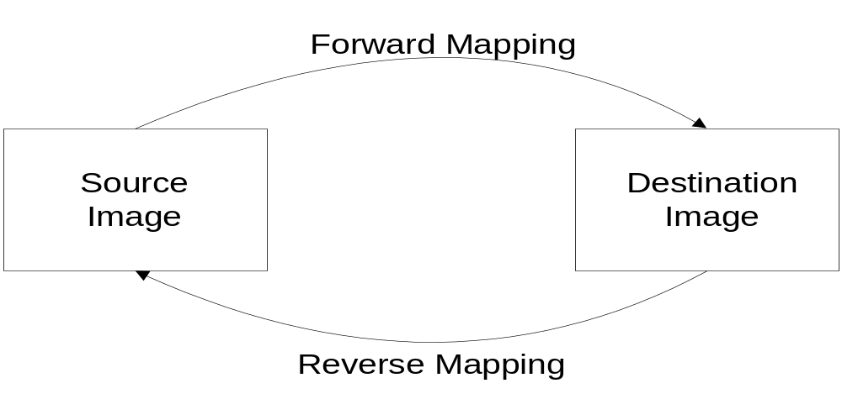
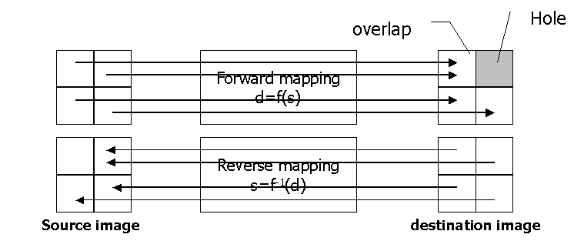
Mapping Schemes
COMSATS University Islamabad, Lahore Campus Digital Image Processing CSD 331

Slide 30
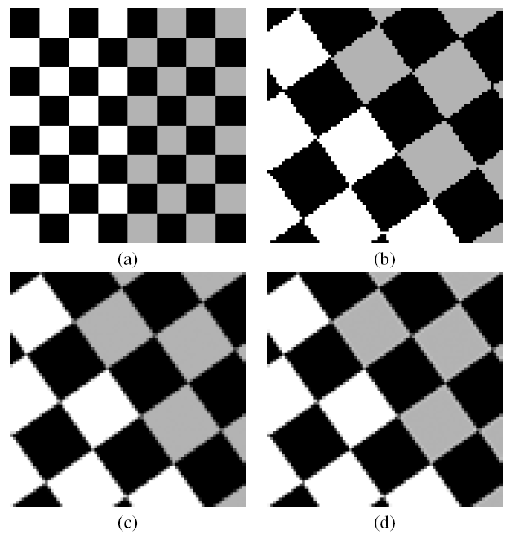
Interpolation Methods
Zero-order (nearest neighbor) interpolation
First-order (bilinear) interpolation
Higher-order interpolations (e.g., bicubic)
COMSATS University Islamabad, Lahore Campus Digital Image Processing CSD 331

Slide 31
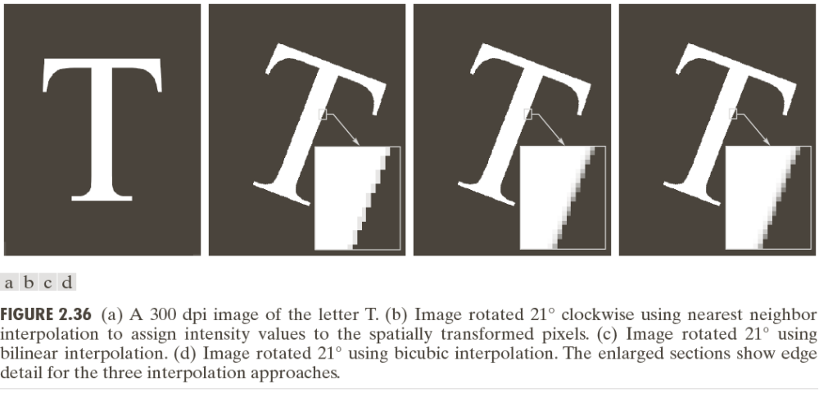
Geometric Spatial Transformations (Rubber Sheet)
COMSATS University Islamabad, Lahore Campus Digital Image Processing CSD 331

Slide 32
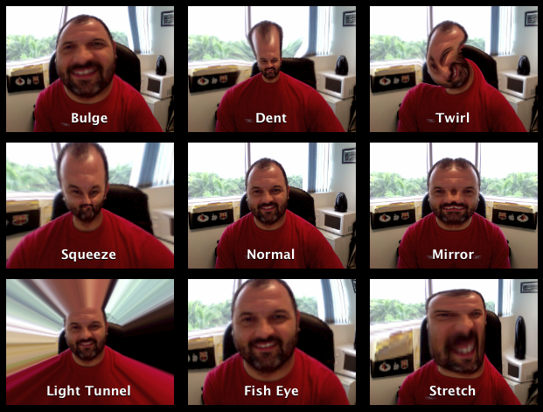
Non Linear Transformations
COMSATS University Islamabad, Lahore Campus Digital Image Processing CSD 331

